Slide 1
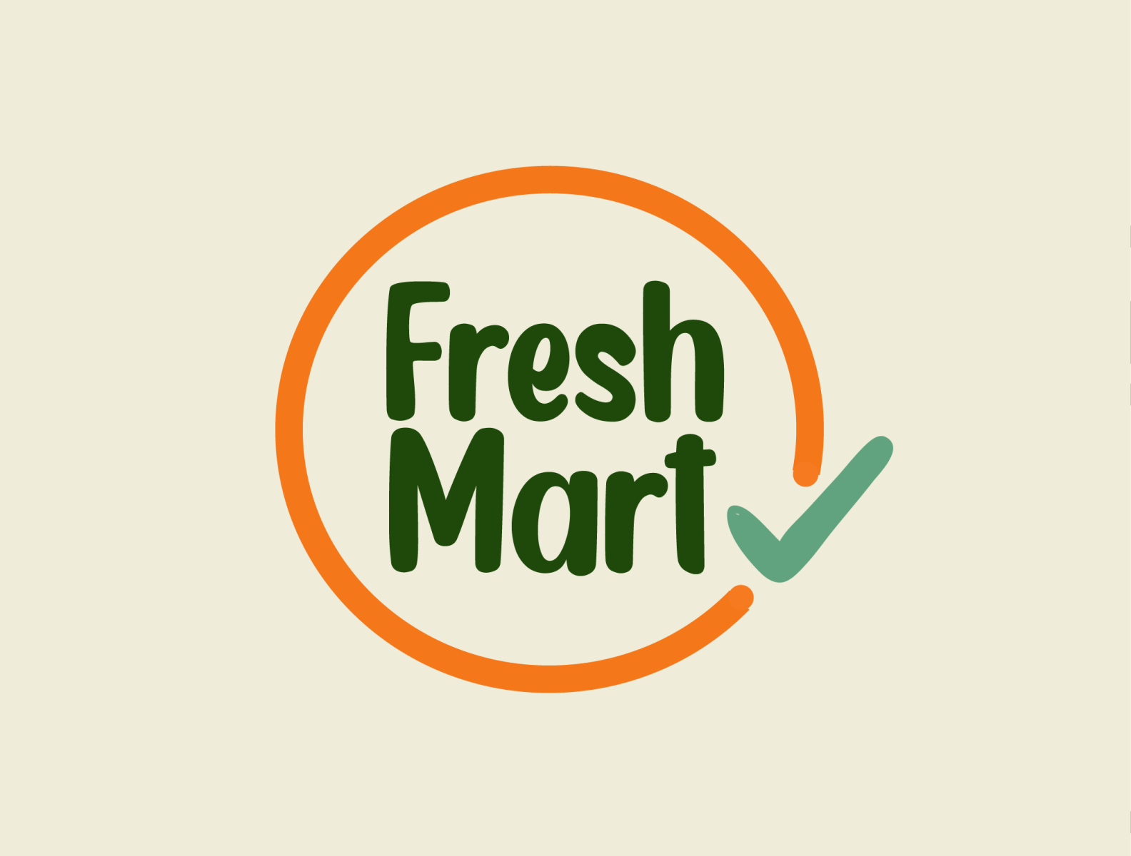
Supermarket management System - (Fresh Mart)
Windows Application Development using C#

Slide 2
Mohmadhusen Khimani
Enrollment No: 22FOTCA11071
My Team
Ghada Ramiz
Enrollment No: 22FOTCA11050
Dodhiya Mohsin
Enrollment No: 22FOTCA11038

Slide 3
What are the topics we are not chosen?
01
02
03
04
05
HOTEL MANAGEMENT SYSTEM
TASK AND PROJECT MANAGEMENT TOOL
LANGUAGE LEARNING APP
DESKTOP EBOOK READER
SUPERMARKET
(FRESH MART) - CHOOSE

Slide 4
HOTEL MANAGEMENT SYSTEM
01

Slide 5

HOTEL MANAGEMENT SYSTEM
PROS:
Streamlines Booking Processes
Enhances Guest Experience
Centralizes Operations
CONS:
Initial Setup Costs
Requires Employee Training
Integration Challenges

Slide 6
TASK AND PROJECT MANAGEMENT TOOL
02

Slide 7

Task and Project Management Tool
PROS:
Organized Workflow
Enhanced Collaboration
Customizable Dashboards
CONS:
Complex Setup
Learning Curve
Data Security

Slide 8
LANGUAGE LEARNING APP
03

Slide 9

Language Learning App
PROS:
Interactive Lessons
Progress Tracking
Multi-Language Support
CONS:
Subscription Costs
Limited Offline Access
Content Variability

Slide 10
DESKTOP EBOOK READER
04

Slide 11

Desktop EBook Reader
PROS:
Customizable Reading Experience
Library Management
Cross-Platform Sync
CONS:
Limited File Format Support
Resource Intensive
Update Dependencies

Slide 12
Our Project - Supermarket Management System (Fresh Mart)

Slide 13
SWOT Analysis of Fresh Mart.
Strengths:
Weaknesses:
Efficient inventory tracking and management.
Streamlined checkout processes with reduced waiting times.
Enhanced customer data collection for personalized marketing.
High initial setup and maintenance costs.
Dependency on reliable internet and system uptime.
Opportunities:
Threats:
Integration with e-commerce platforms for online sales.
Implementation of AI for demand forecasting and customer behavior analysis.
Expansion of digital payment options, including mobile wallets.
Cyber security risks and potential data breaches.
Technological obsolescence and the need for regular upgrades.
Regulatory compliance challenges with data protection laws.

Slide 14
Future Scope
1.Cloud-based Synchronization
2.Artificial Intelligence and Machine Learning
3.Advanced Data Security Features
4.Integration with Advanced Payment Gateways

Slide 15
Why do we need Fresh mart?
Fresh Mart offers the best deals on quality products. Our customers save money while enjoying top-notch groceries and essentials.
It brings the community together. Fresh Mart is a gathering place where people come to shop, socialize, and support local businesses.
It shows what people really want. Our selection reflects the needs and desires of our community, ensuring you get what you need.
It’s a place for everyone. Fresh Mart is for all ages, providing a friendly and welcoming shopping experience.

Slide 16
What are the features of Fresh Mart.
1. Designing Stock In Module and generate reference number
2. Search products using Barcode.
3. Settle Payment and Clear Cart
4. Report daily sale list
5. Cancel Ordered
6. Print preview and receipt
7. Print daily report
8. Notification and Alert Styles

Slide 17
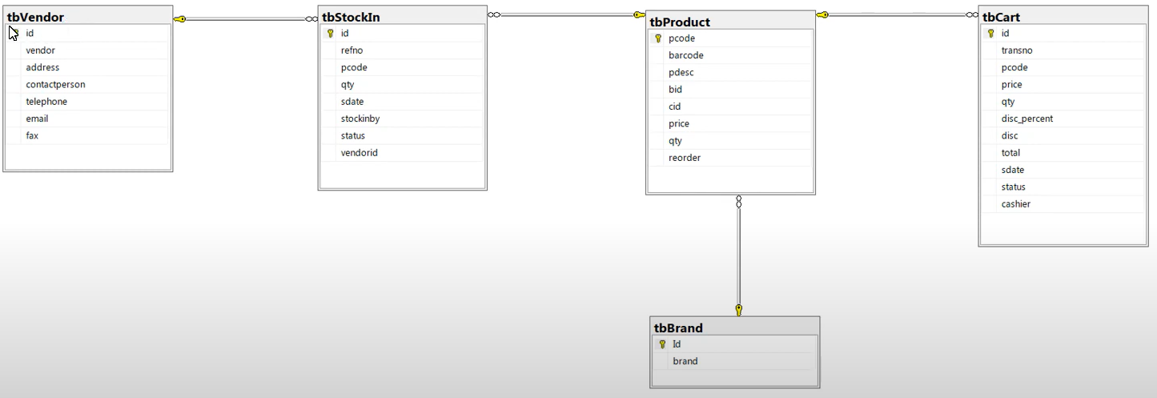
Database Design :

Slide 18
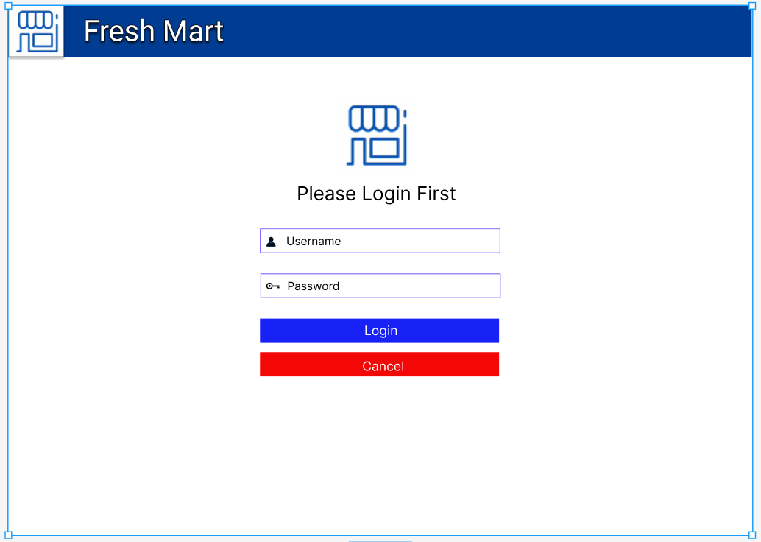
Login Page :

Slide 19
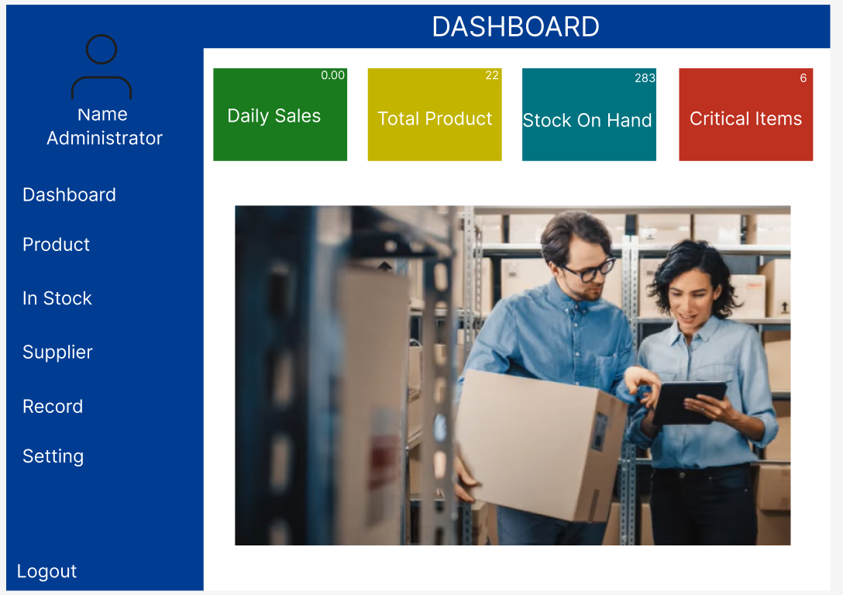
Administrator Dashboard

Slide 20
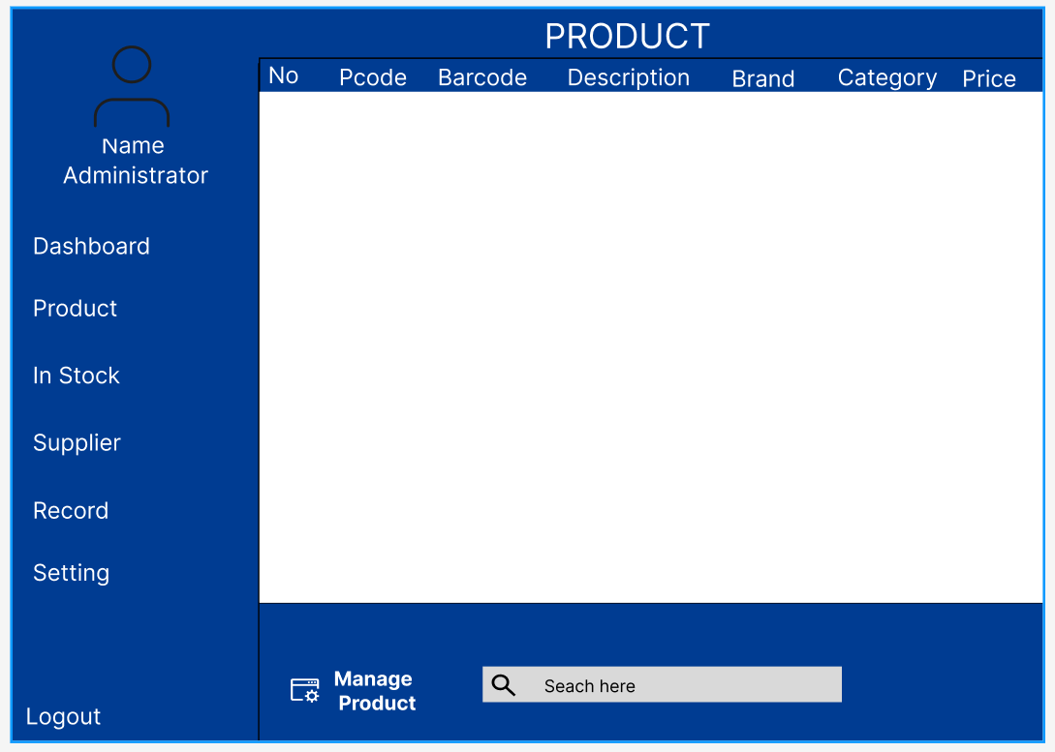
Administrator Product

Slide 21
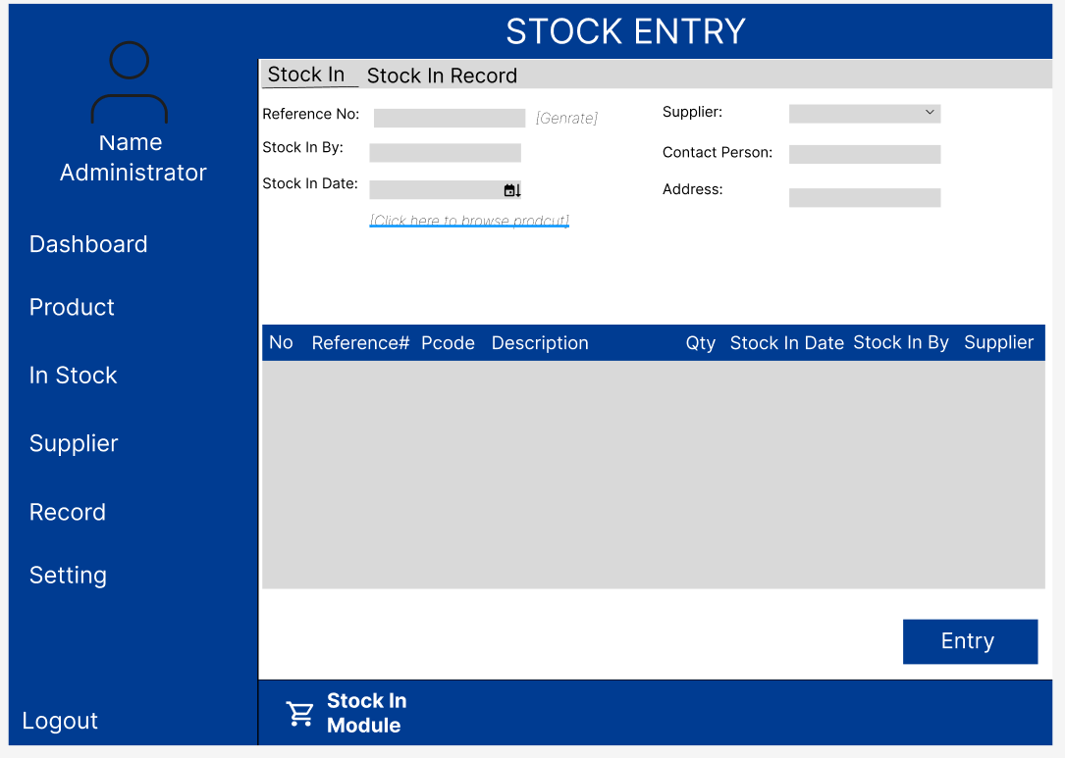
Administrator Stock

Slide 22
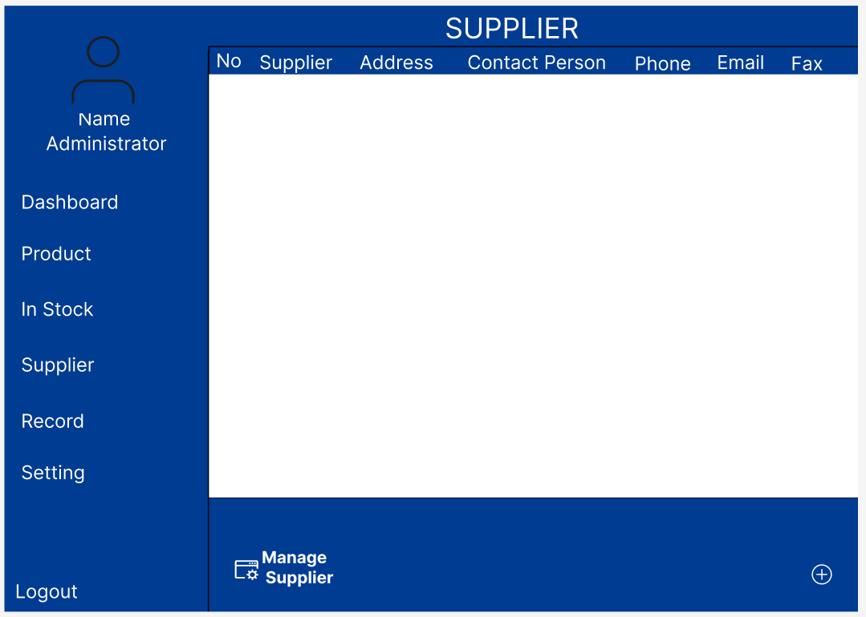
Administrator Supplier

Slide 23
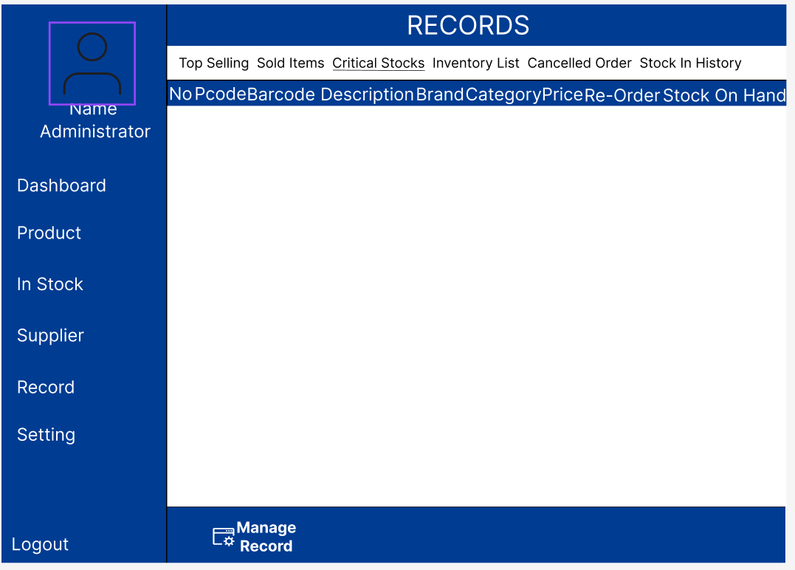
Administrator Records

Slide 24
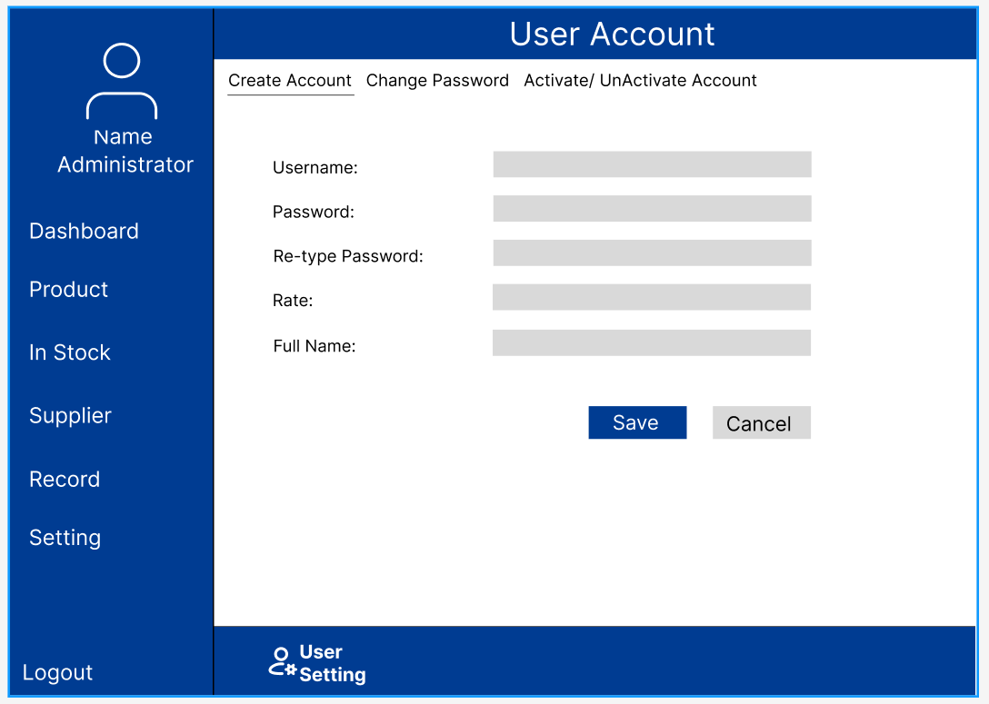
Administrator Setting

Slide 25
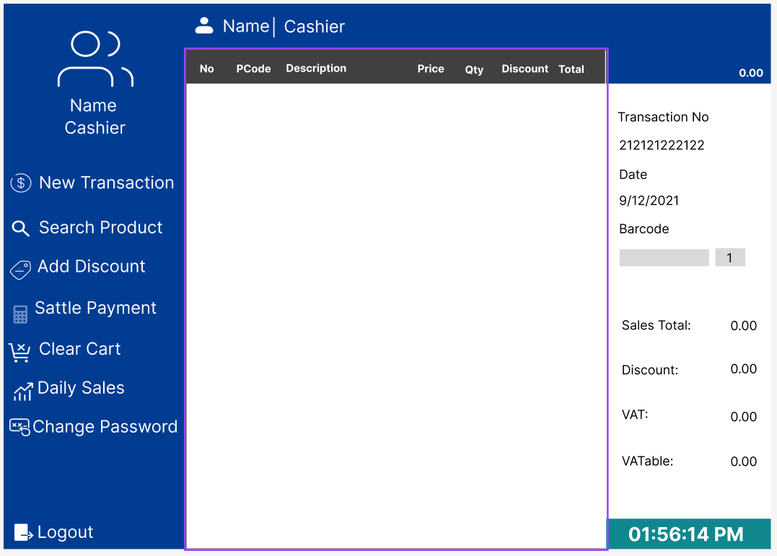
Cashier Dashboard

Slide 26
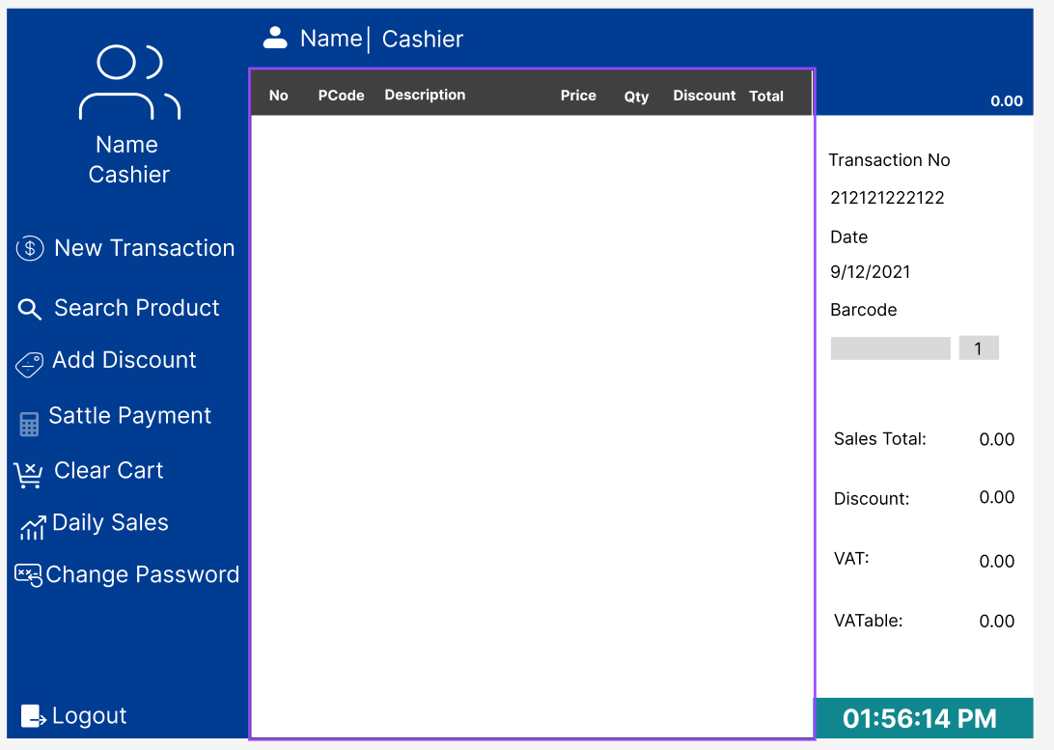
Cashier Search Product

Slide 27
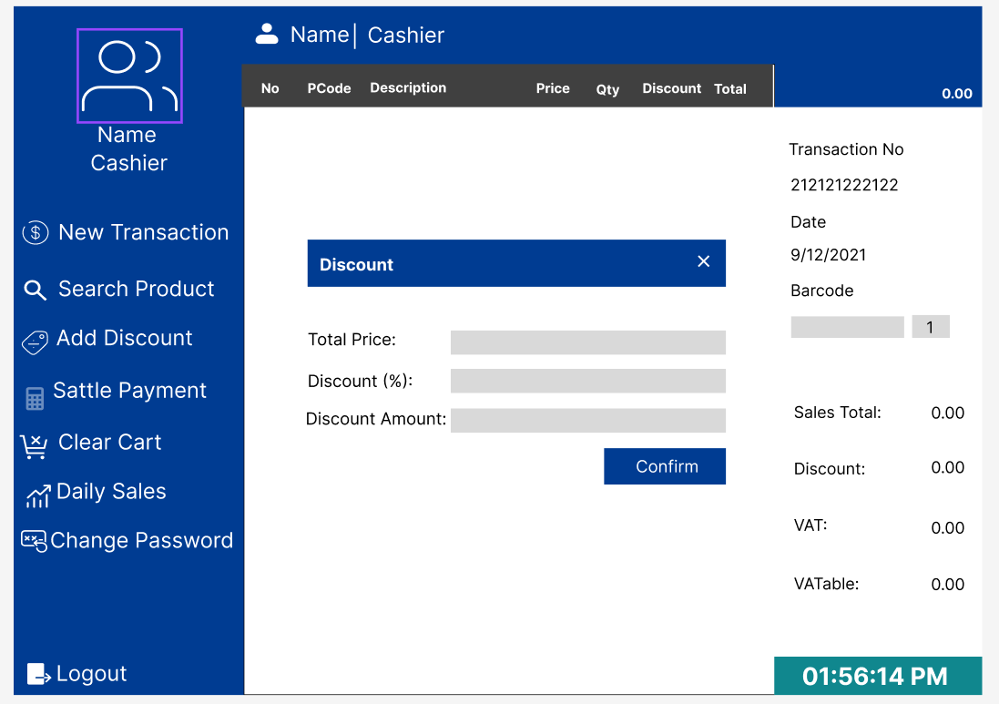
Cashier Add Discount

Slide 28
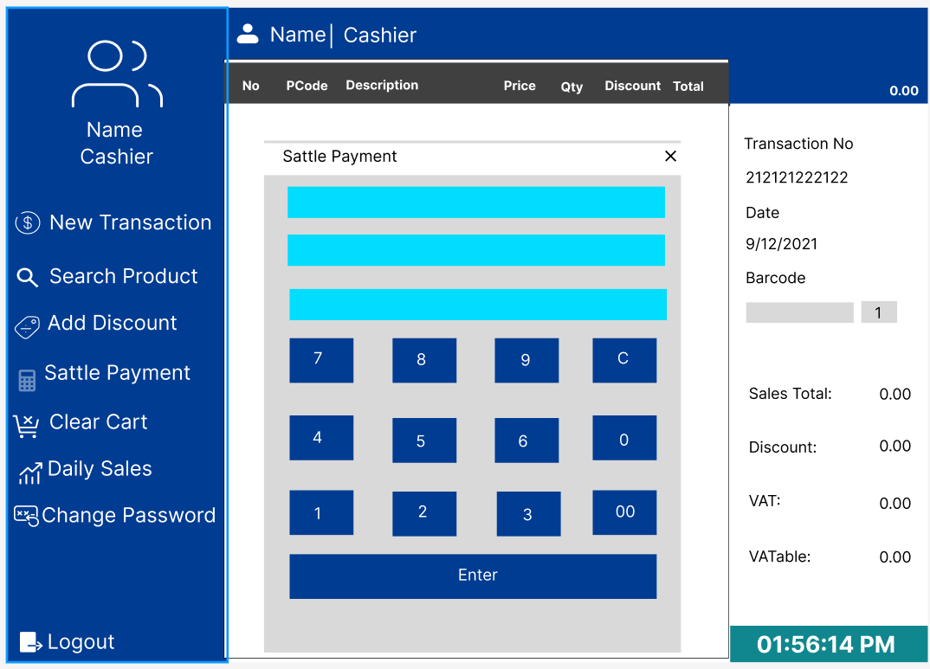
Cashier Sattle Payment

Slide 29
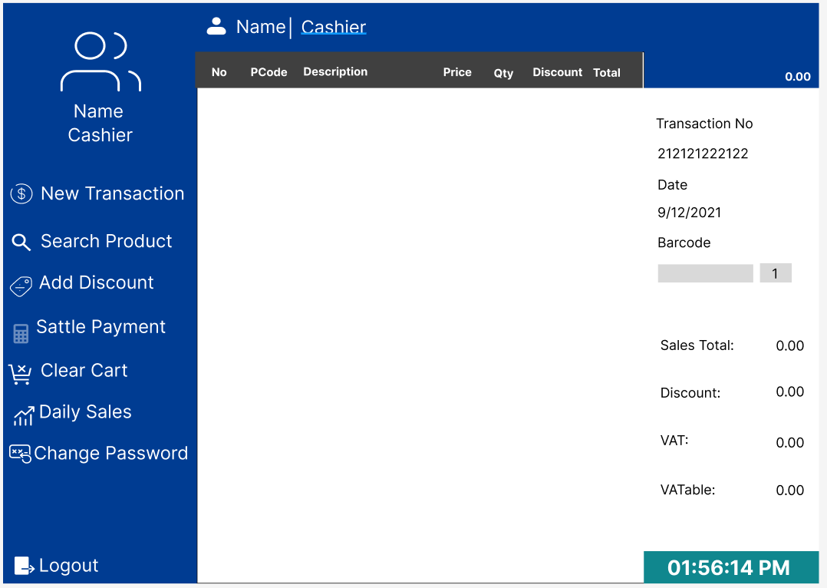
Cashier Clear Cart

Slide 30
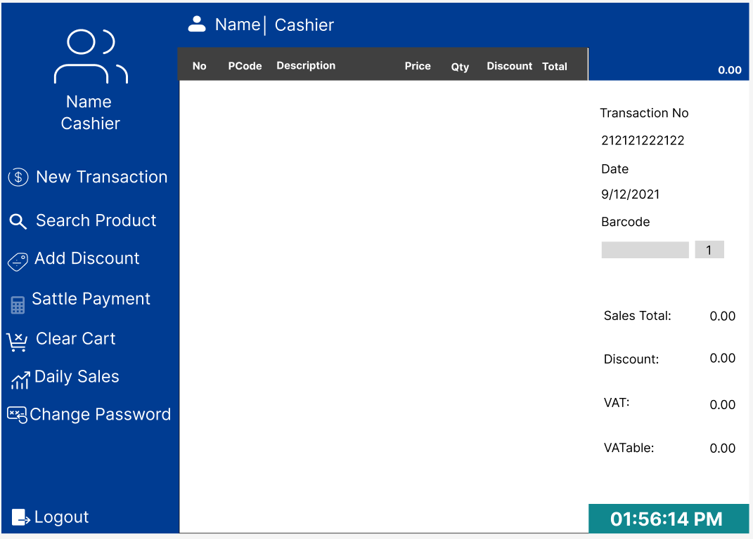
Cashier Daily Sales

Slide 31
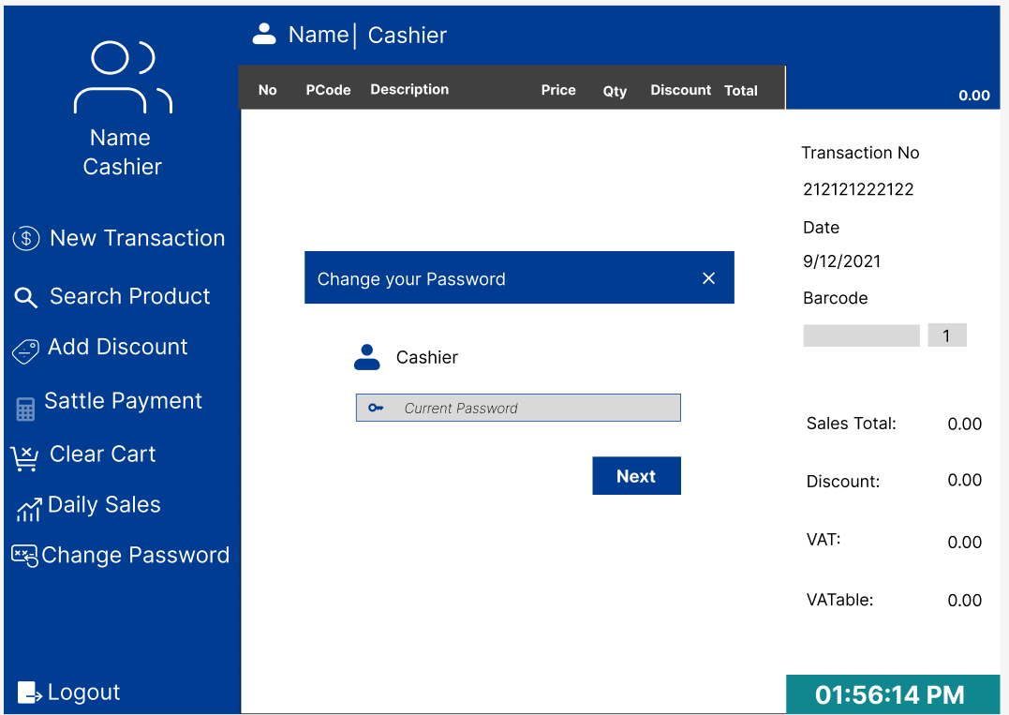
Cashier Change Password

Slide 32
Conclusion
In conclusion, Fresh Mart represents a modern solution for managing supermarket operations efficiently through its C# application. By streamlining inventory management, enhancing customer experience, and optimizing sales tracking, Fresh Mart offers a comprehensive tool for supermarket success. However, it's essential to navigate the challenges of system integration, user training, and ongoing maintenance.

Slide 33

Any Questions?

Slide 34
Thank You!

